Slide 1
Ants!-The battle
By: Syed Ali, Robert Hernandez, and Majed Shaheen

Slide 2
The issue
There has been a civil dispute between two ant colonies. The Reds and Blues.
The Reds believe that food can be achieved from any source, including the picnic basket.
The Blues are more civilized, and would much rather eat from the kitchen counter like normal Ants.
So, they've decided to go to war. . .

Slide 3
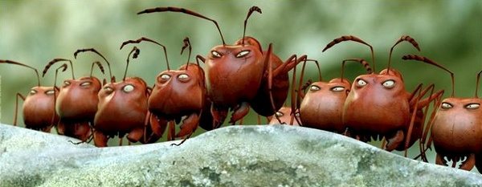
Rules
Ants Fight on (x,y) coordinates
Ant Hierarchy: Worker, Soldier, Knight, Queen
Promotion system
Goal: Kill the Queen of either side and you win!

Slide 4
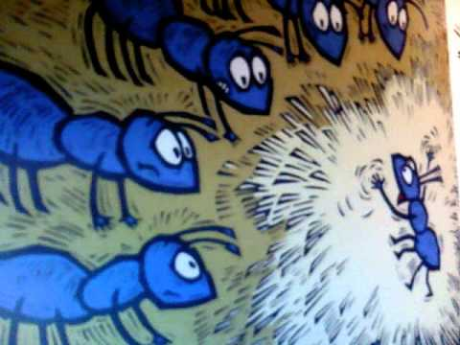
Some Notes
Ants walk in semi-random direction
They do not attack their own ants
Queens do not attack, they're merely the end goal.
Grid
crowd simulator
Possible endings

Slide 5
What we used
Stacks
Vectors
Arrays
Structure
Loggers
Relevant functions(PickAnt,ResolveComabt, etc. . .)

Slide 6
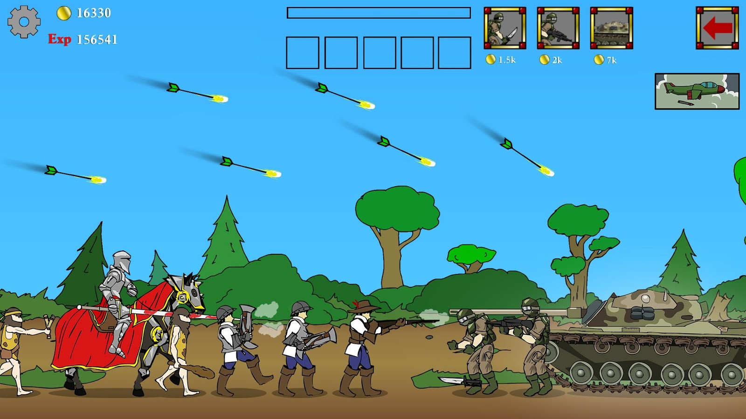
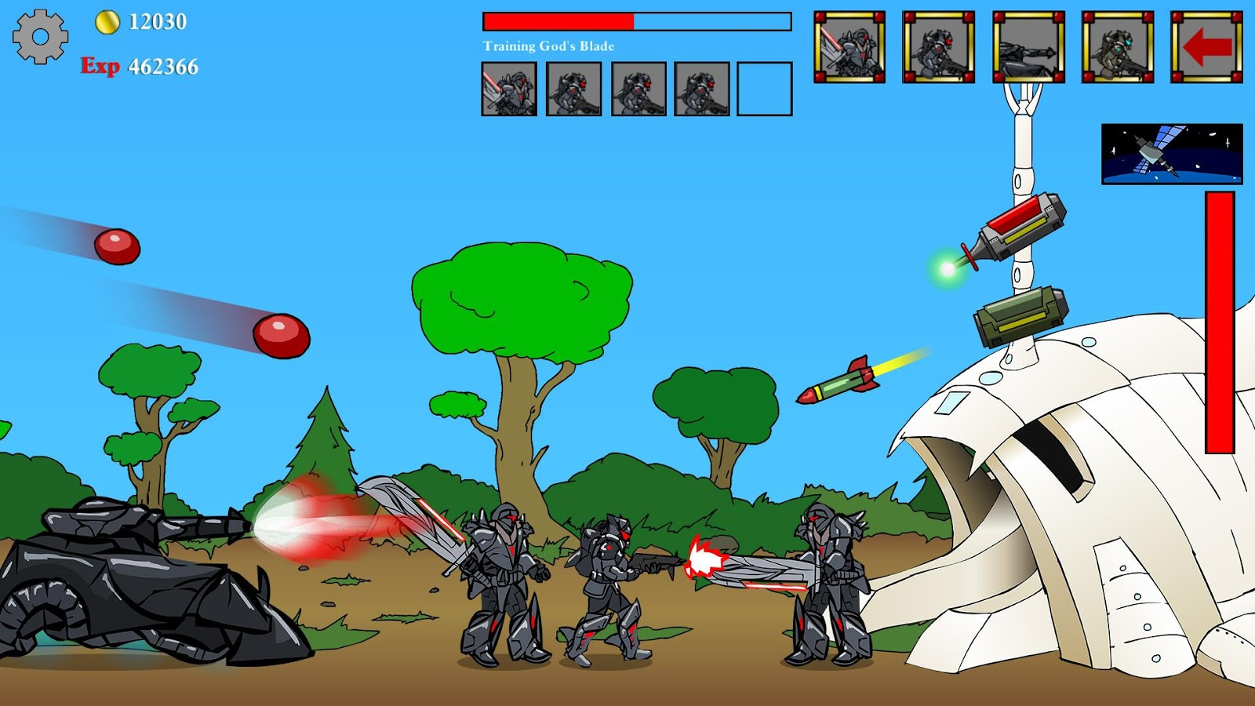
Inspiration

Slide 7
Cited Sources-Pictures
Picture from slide 3: http://saltypopcorn.com.au/wp-content/uploads/2014/05/movie-minuscule-valley-of-the-lost-ants-by-helene-giraud-and-thomas-szabo-s1-mask9.jpg
Picture from slide 4: https://www.youtube.com/watch?v=kmdSUHPwJtc (screenshot)
Age of war link: http://www.addictinggames.com/strategy-games/ageofwar.jsp

